Slide 1
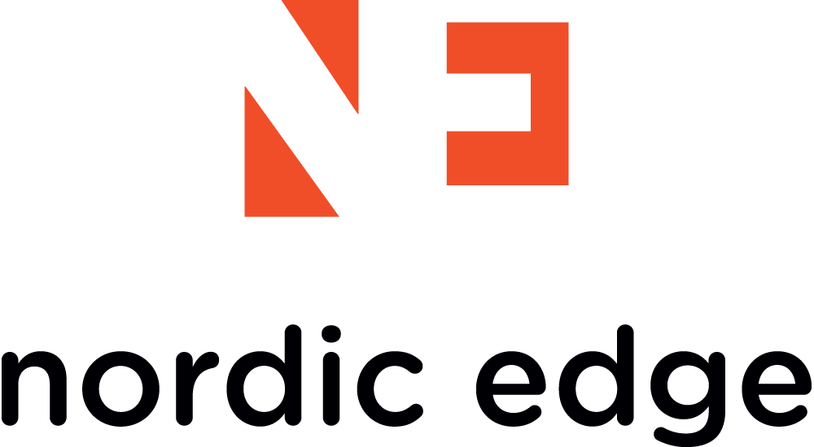
Nordic Edge
Nordic Edge Authentication Platform
Easy, Quick, Reliable Authentication for Both Local and Cloud Applications
www.nordicedge.com
© Nordic Edge™ – The provider of secure identity solutions

Slide 2
Agenda
About Nordic Edge
Solution Overview
OTP3™ Server
Pledge
YubiKey
Customer Case Study
Legacy Token Migration
© Nordic Edge™ – The provider of secure identity solutions

Slide 3
About Nordic Edge
Experts in Identity Management and Access Control with both on premise and in the cloud solutions
Offers a broad range of Identity Management and Strong Authentication solutions
Founded in 2001 in Sweden
Profitable with award winning growth
Over 300 customers in over 30 countries
An independent company
© Nordic Edge™ – The provider of secure identity solutions

Slide 4
Customers
© Nordic Edge™ – The provider of secure identity solutions

Slide 5
Customer Challenges
Username/password no longer offers needed protection, even with strong password policy
Current OTP solutions too expensive and inflexible
Support migration to cloud without loss of security and control
Adapt to changing requirements and increasing use of mobile devices
Increasing regulatory compliance requirements (PCI, SOX, HIPAA, etc…)
© Nordic Edge™ – The provider of secure identity solutions

Slide 6
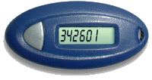
Nordic Edge Strong Authentication
Cloud Services
Local Network
- Two-factor authentication
- Provisioning
- Single Sign-On
Authentication Methods
- SMS
- Mobile Token - Pledge
- YubiKeys
- OATH Tokens
(- Pre-fetched codes)
(- E-mail / Chat)
(- X.509 certificates)
(- Legacy Tokens)
NE Two-factor
Authentication
Server
LDAP
SQL
Internet
Remote Access
© Nordic Edge™ – The provider of secure identity solutions

Slide 7
Nordic Edge Solution Components
Core:
Nordic Edge One Time Password Server (OTP3™)
Main Authentication Options
Nordic Edge Pledge Mobile and PC Token
Nordic Edge SMS Service
Yubico YubiKey USB Token
OATH Hardware Token (HOTP, TOTP, OCRA)
Optional Add-Ons
Nordic Edge Password Kiosk Self Service Portal
AxiaD IDS Installation and Support Services
© Nordic Edge™ – The provider of secure identity solutions

Slide 8
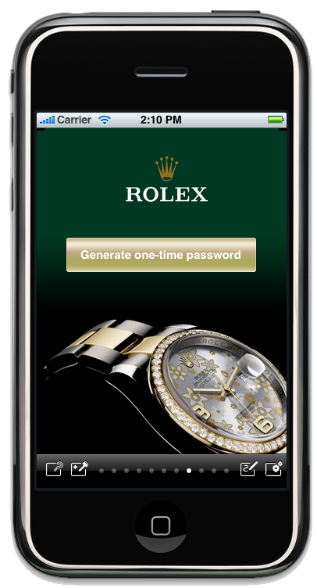
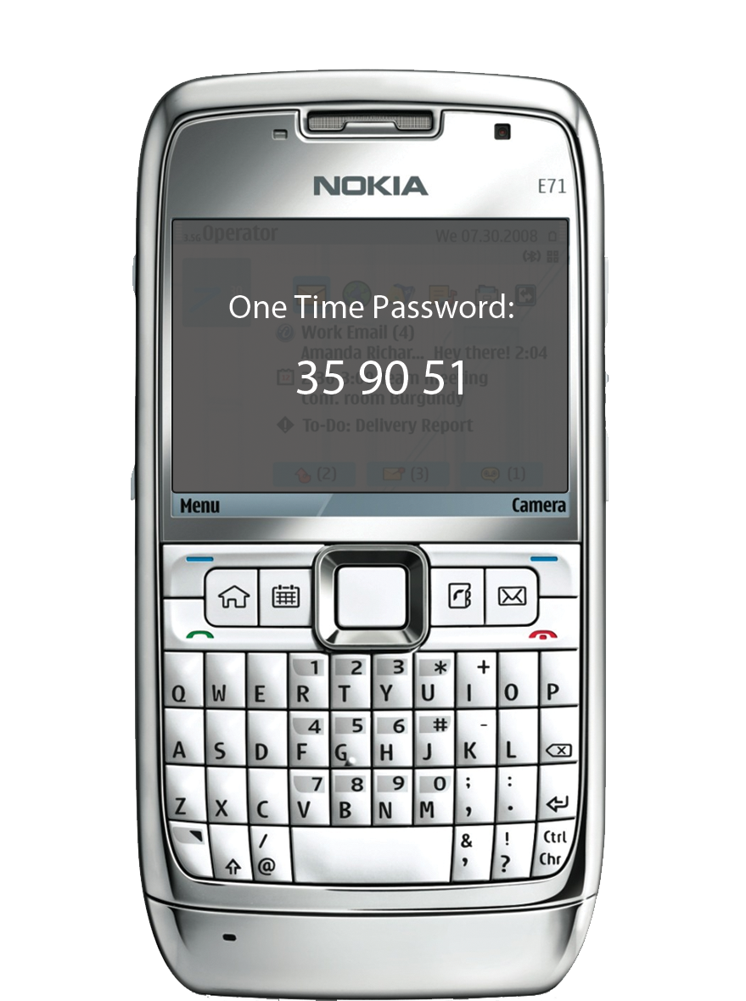
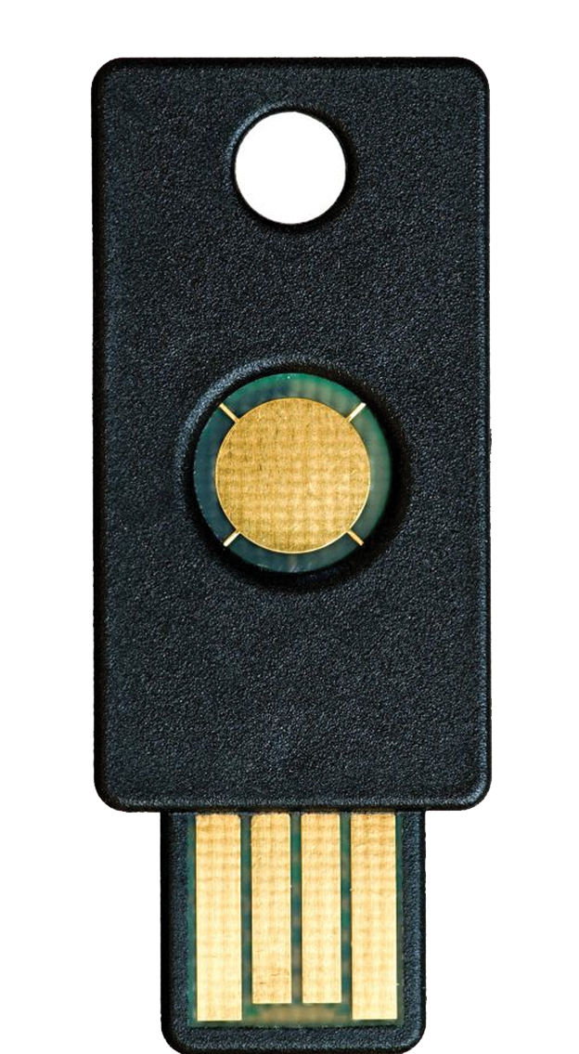
Nordic Edge One Time Password Server
Supports a wide range of authentication methods:
Mobile Token - Pledge
USB Key - YubiKey
SMS
Others: Pre-fetched codes, E-mail / Chat, X.509 certificates, Third Party Tokens (Oath)
Policy based enforcement / choice of authentication methods
Strong authentication to both local and cloud applications
© Nordic Edge™ – The provider of secure identity solutions

Slide 9
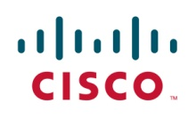
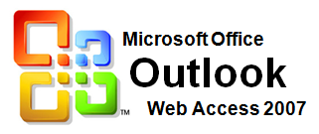
Nordic Edge One Time Password Server
Redundant Scalable Architecture
Failover – avoid downtime
Limitless amount of OTP Servers – supporting millions of users
Java based – run on preferred platform
In production over a million users on one site
Flexible
Comprehensive database support – adapt you current infrastructure
Fast installation
Many Integrations – easy to implement in new environment:
© Nordic Edge™ – The provider of secure identity solutions

Slide 10
Automate and streamline administration
User self enrollment (customized)
User self administration (Password Kiosk)
Automatic Key Enrollment
Benefits:
Significantly reduce administrator time to operate and support solution
Better customer service through automation
© Nordic Edge™ – The provider of secure identity solutions

Slide 11
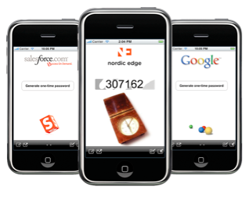
Nordic Edge Pledge Mobile Token
Software that securely generates One Time Password
Runs on all leading platforms:
Blackberry, iPhone, iPad, Android, Windows Mobile
PC/Mac
Automatic key enrollment
No administration
Customized look
Support for signing
Multiple profiles
© Nordic Edge™ – The provider of secure identity solutions

Slide 12
Pledge Token Benefits
Automatic, over the air download and enrollment for instant access
Reduce costs
Automated provisioning
License included for free with OTP Software license
Save from avoiding physical distribution of hardware tokens
Security
PIN protected (optional)
All key material is fully encrypted.
User Convenience
No need to carry a separate OTP token
© Nordic Edge™ – The provider of secure identity solutions

Slide 13
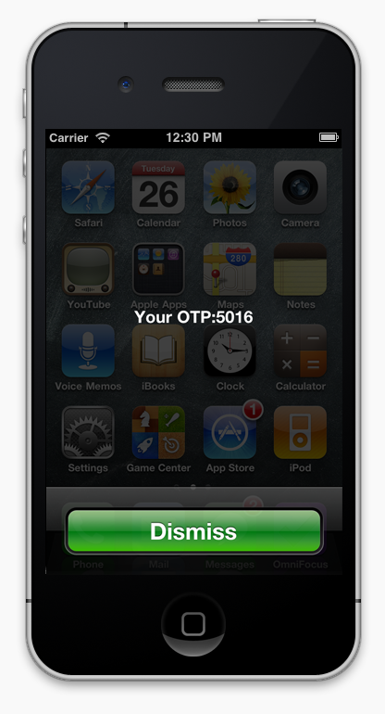
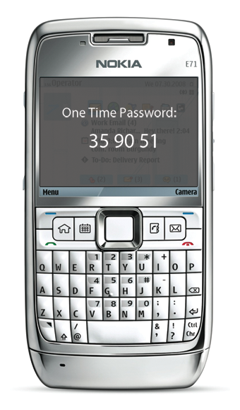
SMS Service
Redundant SMS Server Platform
Validates that message has actually been sent
One fixed price globally
Benefits
No software to install or manage
Main or backup authentication option
© Nordic Edge™ – The provider of secure identity solutions

Slide 14
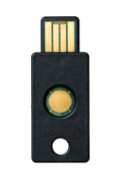
YubiKey
Innovative OTP token: The ”keyboard authenticator”
Simple touch on YubiKey touch button for automatic entry of key identifier and one time password into login field
Works on all computers and platforms
No client software needed
IDENTIFIER
ONE TIME PASSWORD
ccccccccehllvjjitleikcffjndtjkgnrejudfrjncun
ccccccccehllcrnhttrgbgikrcctihnlhclrvhkldcdj
© Nordic Edge™ – The provider of secure identity solutions

Slide 15
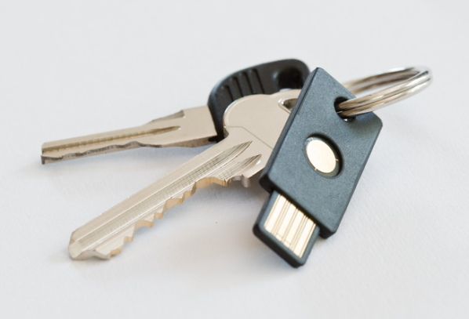
YubiKey Benefits
Flexible
YubiKey 32 bit time variant OTP
OATH with or without Identifier OTP
Two virtual YubiKeys in one
Compact and Robust design
Waterproof, hermetically sealed
Crush safe (survives being run over by a car)
High durability gold contact (+100,000 inserts in USB-port)
No battery, no LCD display, no moving parts
© Nordic Edge™ – The provider of secure identity solutions

Slide 16
Password Kiosk & Self Service Portal
Create custom self service portals
Streamline and automate user provisioning
Offer users increased functionality
Significantly reduce operational costs
© Nordic Edge™ – The provider of secure identity solutions

Slide 17
Cloud Migration
Bridge implementation into cloud environments with Intel’s Expressway Cloud Access 360 solution:
SSO
Provisioning
Fully integrated with Nordic Edge OTP server
Leverage the benefits of cloud services without adding to risk
© Nordic Edge™ – The provider of secure identity solutions

Slide 18
Competitive Differentiation
Nordic Edge OTP | RSA SecurID
Open, Standards Based | Closed, Proprietary
NE supports multiple OTP algorithms, including OATH TOTP, HOTP, OCRA and Yubico | Only Time Based SecurID OTP algorithm
Competitively priced with multiple options not requiring renewal | Expensive, with tokens requiring renewal
Latest Generation | Fundamental Principles unchanged for 20 years
Customers can have full control of key material | Keeps backup of key material
© Nordic Edge™ – The provider of secure identity solutions

Slide 19
What our customers are saying
"We were impressed by the rapid implementation of the system, but also by the ease-of-use for our users and the low administration required"
Prof. Gerd Stöwer, CEO Münster/Osnabrück Airport
"We are very satisfied with Your product. It’s very stable, easy to use, fast, reliable and it has good logging abilities. So we think that Nordic Edge OTP server was the best choice to our services"
Ernest Jojart, member of the developer team in AXA Group
"The OTP server has saved us from having a hacker gaining access using stolen credentials on a remote system. It also alerted the user, who could report the intrusion attempt to the system administrator. The system has been up and running without a single failure since we brought it online in 2008.”
Jonas Lindemann, Senior system manager, Lunds Universitet
© Nordic Edge™ – The provider of secure identity solutions

Slide 20
Customer Case Study
Hughes is the world’s leading provider of satellite broadband for home and office, delivering innovative network technologies, managed services, and solutions for enterprises and governments globally.
Solution Overview
Benefits
Uses Nordic Edge OTP3 Server as their back-end authentication server and IM Suite for Self-Enrollment and Administration Portal
Switched from distributing RSA SecurID tokens to Yubico “YubiKeys” to their customers
Installed User Self Enrollment Portal to enable users to automatically enroll previously unassigned tokens and manage these tokens
Uses a combination of Yubico OATH YubiKeys and ActivIdentity OATH display tokens
Large cost saver in distribution, administration and purchase of YubiKeys instead of RSA tokens
Less Administration - user self enrollment saves Hughes huge amounts of time and money
More flexible back-end in the Nordic Edge OTP3 Server
Can use any combination of OATH tokens, Pledge and SMS authentication
More secure back-end (no seed file handling)
© Nordic Edge™ – The provider of secure identity solutions

Slide 21
Conclusion
Nordic Edge Strong Authentication
Versatile and robust platform for all enterprise needs
Choice of authentication methods
Rapid installation, integration and deployment
Support for YubiKey
Low cost of operation through maximized self service
Attractive pricing model
© Nordic Edge™ – The provider of secure identity solutions

Slide 22
Backup Slides
Migration from Legacy Solution, e.g. RSA SecurID
© Nordic Edge™ – The provider of secure identity solutions

Slide 23
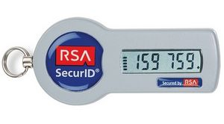
Legacy Token Setup
Remote Access Product
Legacy
Authentication Server
Legacy Token
Token Db
User 5 | ID-123
User 4 | ID-124
User 6 | ID-241
© Nordic Edge™ – The provider of secure identity solutions

Slide 24
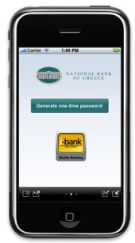
Legacy --> Nordic Edge
Legacy
Authentication Server
Legacy
Token DB
Legacy Token
User 5 | ID-123
User 4 | ID-124
User 6 | ID-241
Remote Access Product
One Time
Password Server
YubiKey
Users LDAP
User 1 | Pledge | ID-231
User 2 | Legacy token | ID-123
User 3 | YubiKey | ID-414
Pledge
© Nordic Edge™ – The provider of secure identity solutions
Notes:
1) Vasco users will still use their Vasco token when logging in
2) Once Vasco users are enrolled with Pledge or SMS, several options are available
a) The Vasco token is disabled and the user must use Pledge/SMS
b) The Vasco token is still enabled for the user and the user has a choice between Vasco, Pledge/SMS
c) Prioritized authentication methods can be configured. All authentication methods are available according to priority for each user.

Slide 25
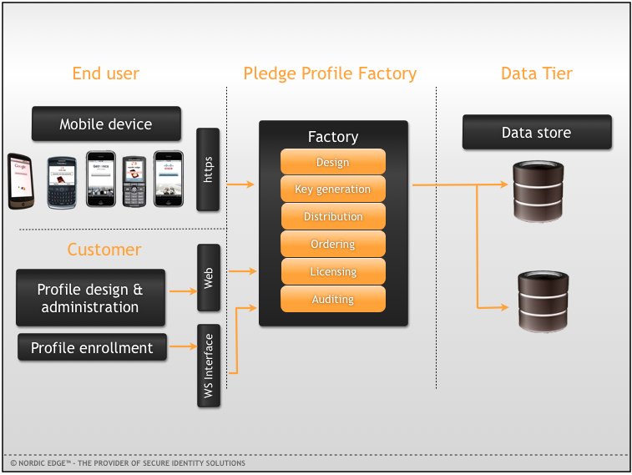
Pledge Enrollment Overview
© Nordic Edge™ – The provider of secure identity solutions

Slide 26
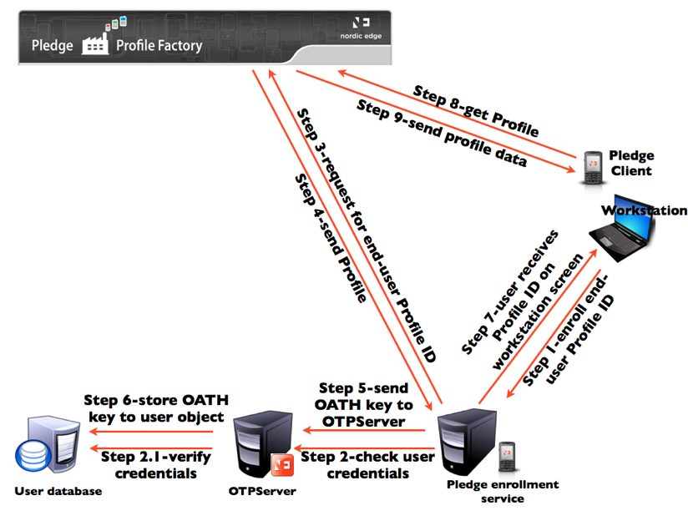
Pledge Enrollment (cont).
© Nordic Edge™ – The provider of secure identity solutions

Slide 27
Thank you!
Henrik Åkerstrand
Business Development Manager
hakerstrand@nordicedge.se
+46 708 320 404
Jan T. Johansen
Sales Manager North America
jjohansen@nordicedge.se
(510) 755-1162
© Nordic Edge™ – The provider of secure identity solutions

